Slide 1
CSE 417T Introduction to Machine Learning
Lecture 8 Instructor: Chien-Ju (CJ) Ho

Slide 2
Logistics
HW1: Due Sep 23
Reserve time if you have never used Gradescope
Check that submission is readable (if you scan your handwriting)
Correctly assign pages to each problem (you won’t get points otherwise)
HW2: Will be announce later today or tomorrow
Expect roughly two weeks to work on it
Exam dates
Exam 1: October 27
We expect to finish the content for exam1 several lectures before the exam.
Exam 2: December 8

Slide 3
Recap

Slide 4
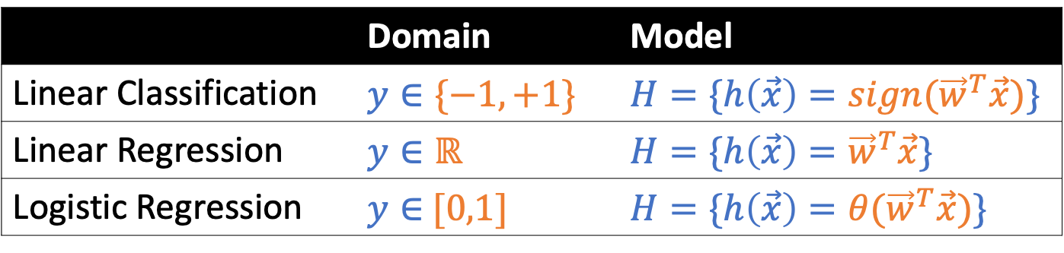
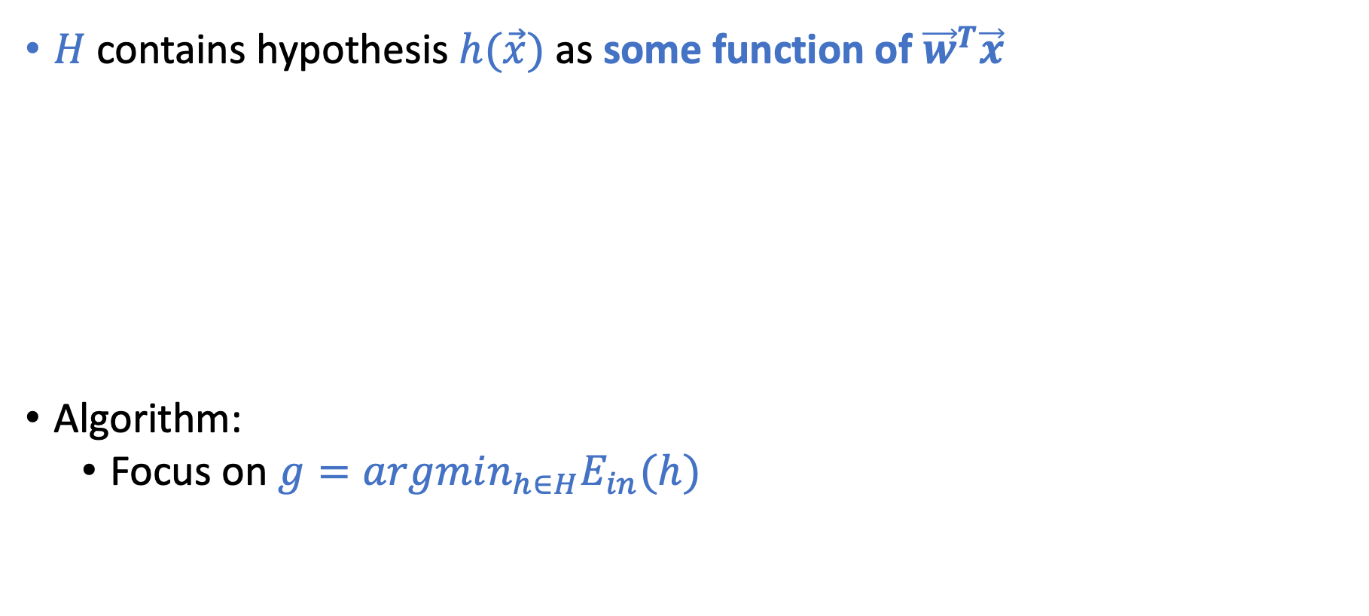
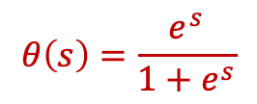
Linear Models
This is why it’s called linear models
$H$ contains hypothesis $h(\vec{x})$ as some function of ${\vec{w}}^{T}\vec{x}$
Algorithm:
Focus on $g=argmin_{h∈H}E_{in}(h)$
 | Domain | Model
Linear Classification | $$y∈\{−1,+1\}$$ | $$H=\{h\left(\vec{x}\right)={sign(\vec{w}}^{T}\vec{x})\}$$
Linear Regression | $$y∈ℝ$$ | $$H=\{h\left(\vec{x}\right)={\vec{w}}^{T}\vec{x}\}$$
Logistic Regression | $y∈$ $[0,1]$ | $$H=\{h\left(\vec{x}\right)={θ(\vec{w}}^{T}\vec{x})\}$$
Credit Card Example
Approve or not
Credit line
Prob. of default
$$θ\left(s\right)=\frac{e^{s}}{1+e^{s}}$$

Slide 5

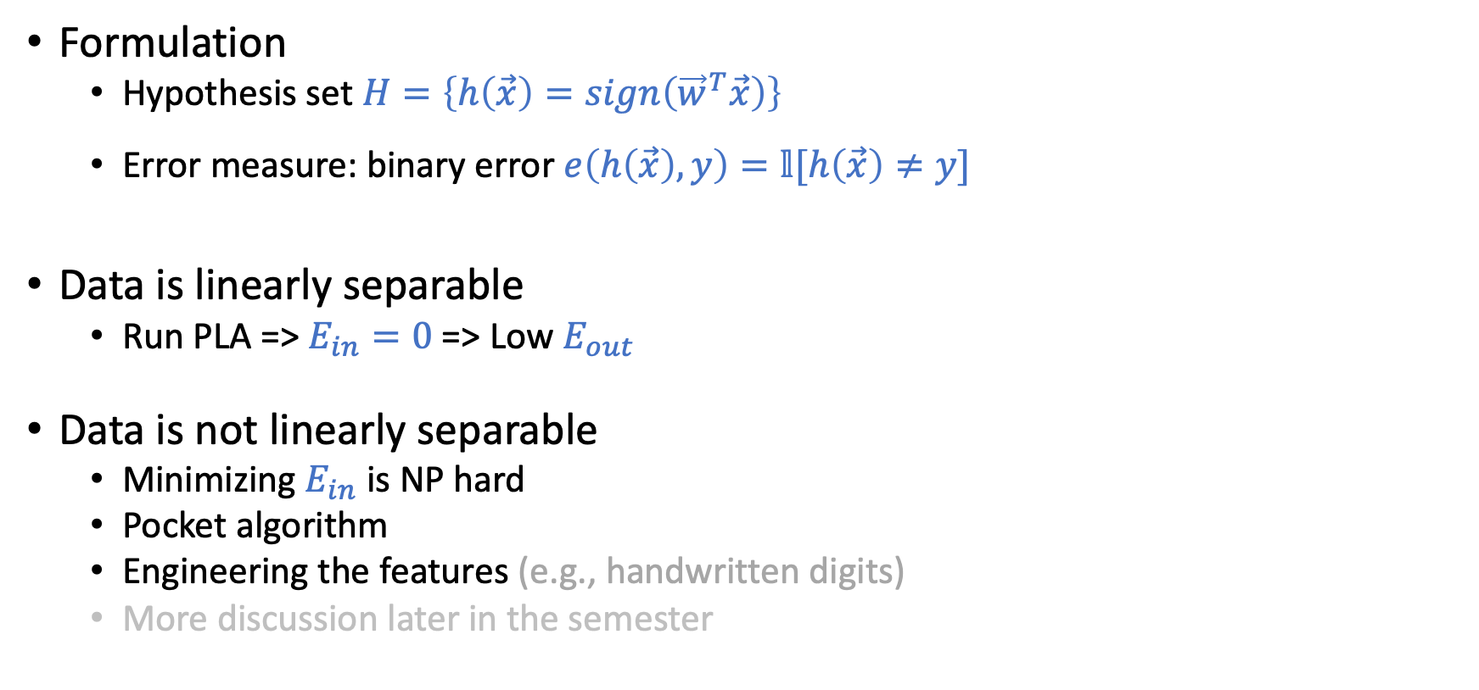
Linear Classification (Perceptron)
Formulation
Hypothesis set $H=\left\{h\left(\vec{x}\right)=sign\left({\vec{w}}^{T}\vec{x}\right)\right\}$
Error measure: binary error $e\left(h\left(\vec{x}\right),y\right)=𝕝[h\left(\vec{x}\right)≠y]$
Data is linearly separable
Run PLA => $E_{in}=0$ => Low $E_{out}$
Data is not linearly separable
Minimizing $E_{in}$ is NP hard
Pocket algorithm
Engineering the features (e.g., handwritten digits)
More discussion later in the semester

Slide 6
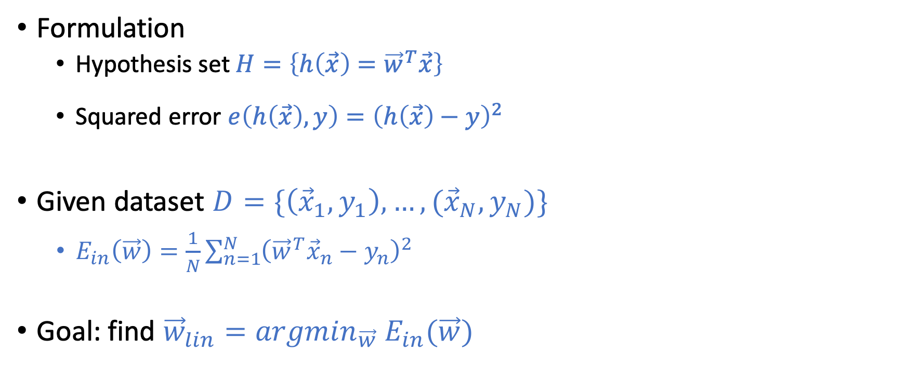
Linear Regression
Formulation
Hypothesis set $H=\left\{h\left(\vec{x}\right)={\vec{w}}^{T}\vec{x}\right\}$
Squared error $e\left(h\left(\vec{x}\right),y\right)={\left(h\left(\vec{x}\right)−y\right)}^{2}$
Given dataset $D=\{\left({\vec{x}}_{1},y_{1}\right),…,({\vec{x}}_{N},y_{N})\}$
$E_{in}\left(\vec{w}\right)=\frac{1}{N}\sum_{n=1}^{N}{{\left({{\vec{w}}^{T}\vec{x}}_{n}−y_{n}\right)}^{2}}$
Goal: find ${\vec{w}}_{lin}={argmin}_{\vec{w}} E_{in}(\vec{w})$

Slide 7
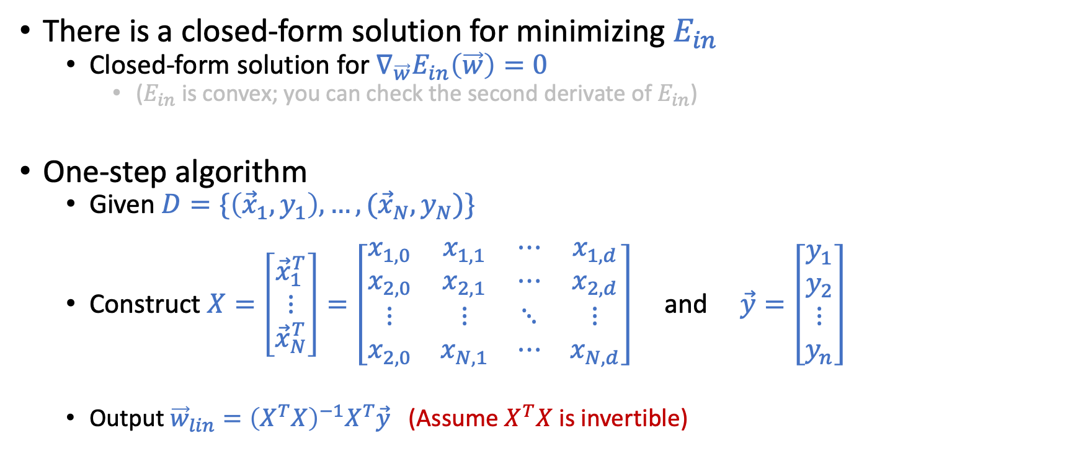
Linear Regression “Algorithm”
There is a closed-form solution for minimizing $E_{in}$
Closed-form solution for $∇_{\vec{w}}E_{in}\left(\vec{w}\right)=0$
($E_{in}$ is convex; you can check the second derivate of $E_{in}$)
One-step algorithm
Given $D=\{\left({\vec{x}}_{1},y_{1}\right),…,({\vec{x}}_{N},y_{N})\}$
Construct $X=\left[\begin{matrix}{\vec{x}}_{1}^{T} \\ ⋮ \\ {\vec{x}}_{N}^{T}\end{matrix}\right]=\left[\begin{matrix}x_{1,0} & x_{1,1} & ⋯ & x_{1,d} \\ x_{2,0} & x_{2,1} & ⋯ & x_{2,d} \\ ⋮ & ⋮ & ⋱ & ⋮ \\ x_{2,0} & x_{N,1} & ⋯ & x_{N,d}\end{matrix}\right]$ and $\vec{y}=\left[\begin{matrix}y_{1} \\ y_{2} \\ ⋮ \\ y_{n}\end{matrix}\right]$
Output ${\vec{w}}_{lin}={\left(X^{T}X\right)}^{−1}X^{T}\vec{y}$ (Assume $X^{T}X$ is invertible)

Slide 8
Today’s Lecture
The notes are not intended to be comprehensive. They should be accompanied by lectures and/or textbook.
Let me know if you spot errors.

Slide 9
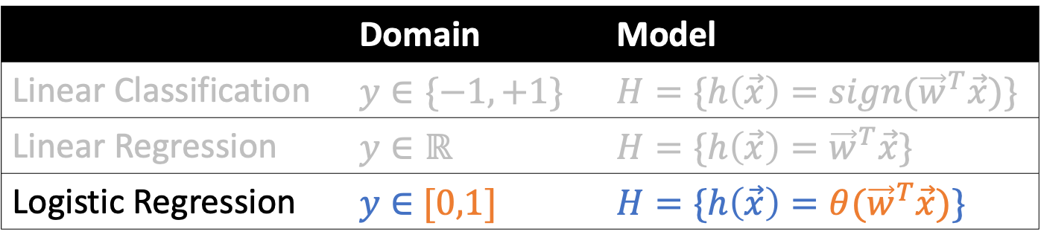
Logistic Regression
 | Domain | Model
Linear Classification | $$y∈\{−1,+1\}$$ | $$H=\{h\left(\vec{x}\right)={sign(\vec{w}}^{T}\vec{x})\}$$
Linear Regression | $$y∈ℝ$$ | $$H=\{h\left(\vec{x}\right)={\vec{w}}^{T}\vec{x}\}$$
Logistic Regression | $y∈$ $[0,1]$ | $$H=\{h\left(\vec{x}\right)={θ(\vec{w}}^{T}\vec{x})\}$$

Slide 10
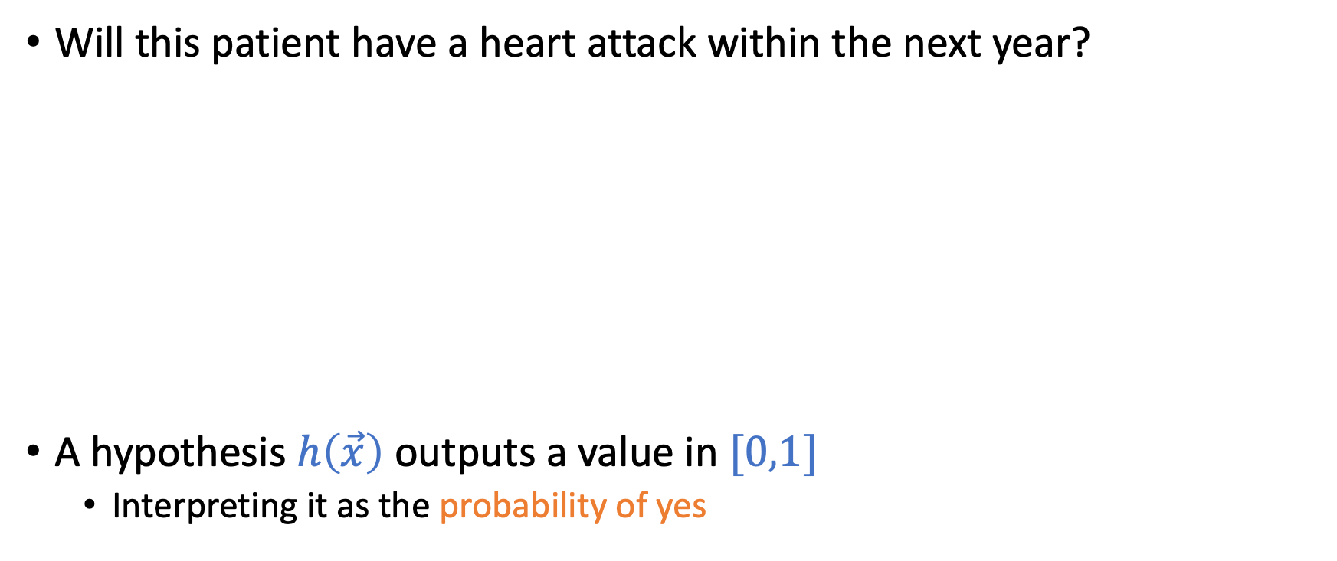
Logistic Regression: Predicting a Probability
Will this patient have a heart attack within the next year?
A hypothesis $h\left(\vec{x}\right)$ outputs a value in $[0,1]$
Interpreting it as the probability of yes
Classification: Yes/No
Logistic regression: Probability of Yes

Slide 11
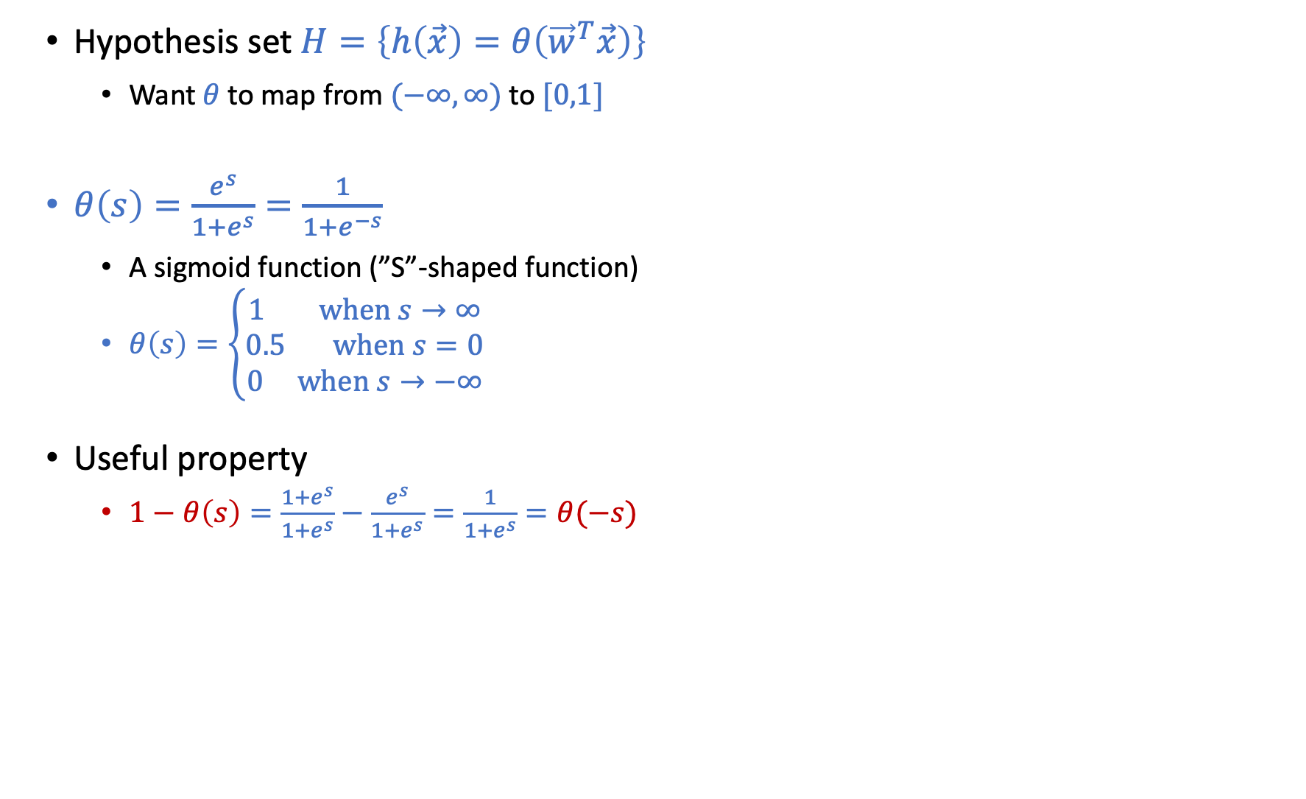
Logistic Regression: Predicting a Probability
Hypothesis set $H=\left\{h\left(\vec{x}\right)=θ\left({\vec{w}}^{T}\vec{x}\right)\right\}$
Want $θ$ to map from $(−∞,∞)$ to $[0,1]$
$θ\left(s\right)=\frac{e^{s}}{1+e^{s}}=\frac{1}{1+e^{−s}}$
A sigmoid function (”S”-shaped function)
$θ\left(s\right)=\left\{\begin{aligned}1 \text{when} s→∞ \\ 0.5 \text{when} s=0 \\ 0 \text{when} s→−∞\end{aligned}\right.$
Useful property
$1−θ\left(s\right)=\frac{1+e^{s}}{1+e^{s}}−\frac{e^{s}}{1+e^{s}}=\frac{1}{1+e^{s}}=θ(−s)$

Slide 12
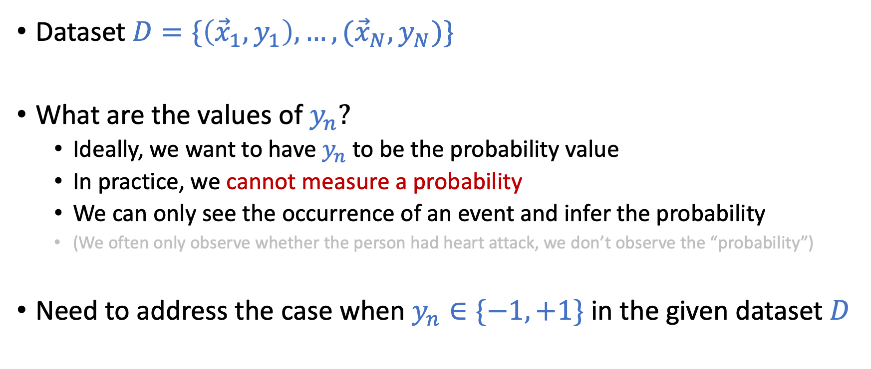
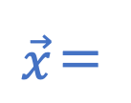
What Kind of Dataset do We Get?
Dataset $D=\{\left({\vec{x}}_{1},y_{1}\right),…,({\vec{x}}_{N},y_{N})\}$
What are the values of $y_{n}?$
Ideally, we want to have $y_{n}$ to be the probability value
In practice, we cannot measure a probability
We can only see the occurrence of an event and infer the probability
(We often only observe whether the person had heart attack, we don’t observe the “probability”)
Need to address the case when $y_{n}∈\{−1,+1\}$ in the given dataset $D$
$$\vec{x}＝$$

Slide 13
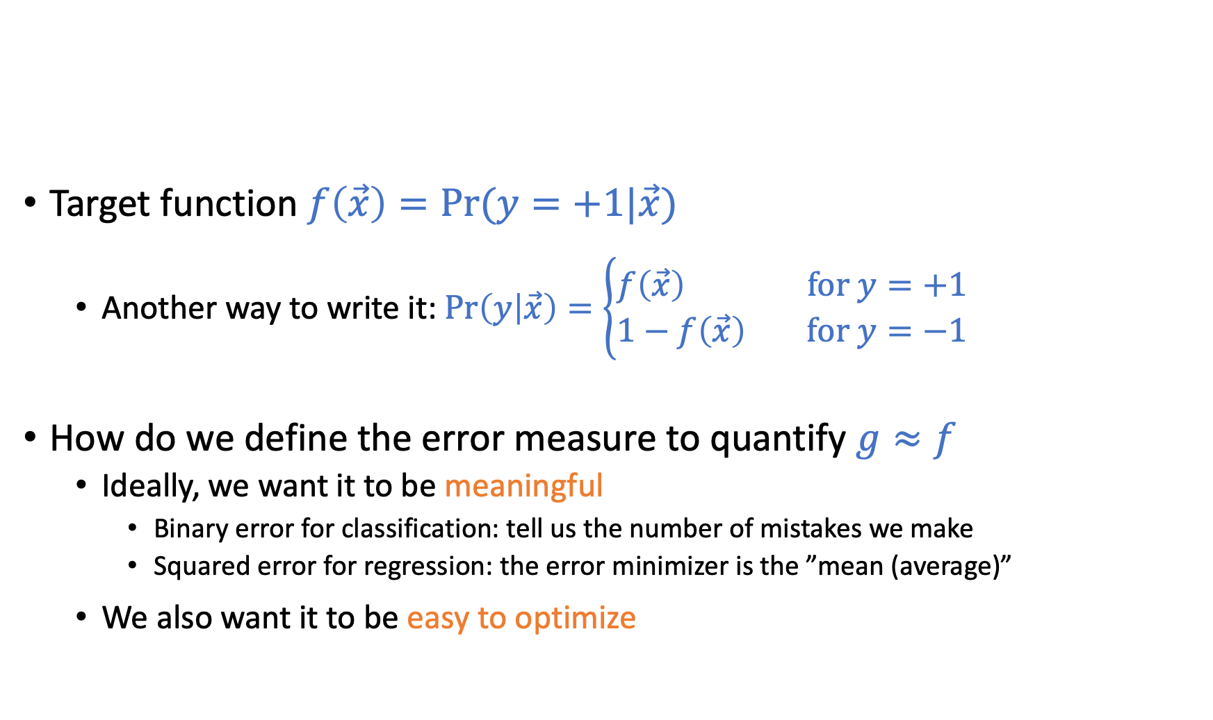

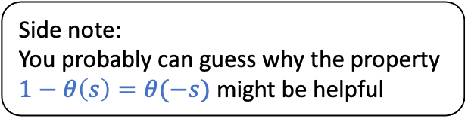
Error Measure: Quantifying $g≈f$
Side note:
You probably can guess why the property $1−θ\left(s\right)=θ(−s)$ might be helpful
Target function $f\left(\vec{x}\right)=Pr⁡(y=+1|\vec{x})$
Another way to write it: $\operatorname{Pr}\left(y | \vec{x}\right)=\left\{\begin{aligned}f\left(\vec{x}\right) \text{for} y=+1 \\ 1−f\left(\vec{x}\right) \text{for} y=−1\end{aligned}\right.$
How do we define the error measure to quantify $g≈f$
Ideally, we want it to be meaningful
Binary error for classification: tell us the number of mistakes we make
Squared error for regression: the error minimizer is the ”mean (average)”
We also want it to be easy to optimize

Slide 14
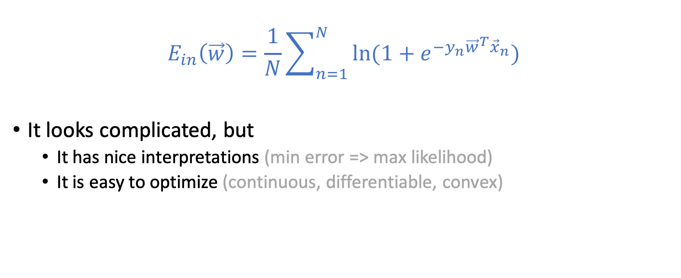
Cross Entropy Error
$$E_{in}\left(\vec{w}\right)=\frac{1}{N}\sum_{n=1}^{N}{\ln{(1+e^{−y_{n}{\vec{w}}^{T}{\vec{x}}_{n}})}}$$
It looks complicated, but
It has nice interpretations (min error => max likelihood)
It is easy to optimize (continuous, differentiable, convex)

Slide 15
Minimizing Cross Entropy Error Maximizing Likelihood

Slide 16
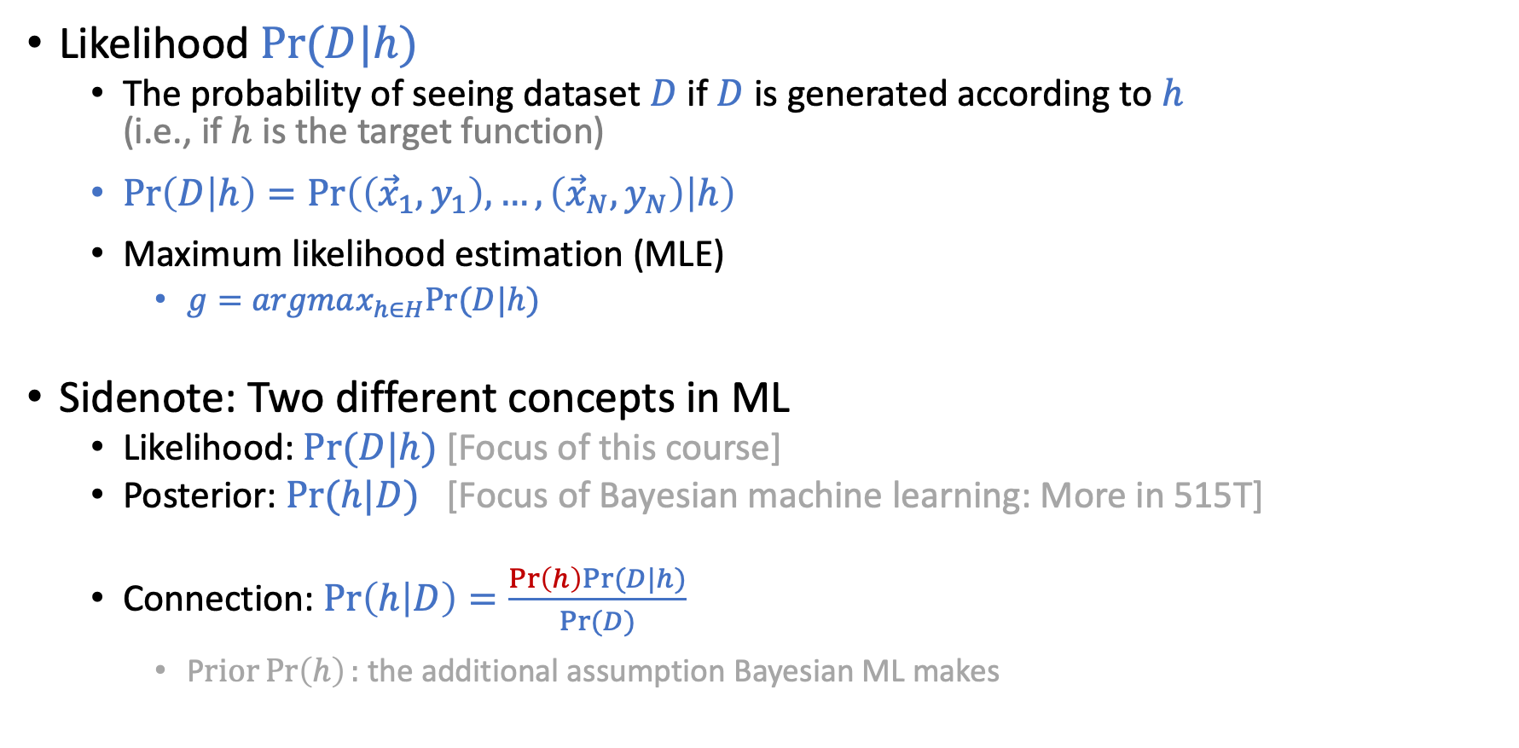
Maximum Likelihood Estimation
Likelihood $Pr⁡(D|h)$
The probability of seeing dataset $D$ if $D$ is generated according to $h$ (i.e., if $h$ is the target function)
$\operatorname{Pr}\left(D | h\right)=\operatorname{Pr}\left(\left({\vec{x}}_{1},y_{1}\right),…,\left({\vec{x}}_{N},y_{N}\right) | h\right)$
Maximum likelihood estimation (MLE)
$g=argmax_{h∈H}Pr⁡(D|h)$
Sidenote: Two different concepts in ML
Likelihood: $Pr⁡(D|h)$ [Focus of this course]
Posterior: $\operatorname{Pr}{(h|D)}$ [Focus of Bayesian machine learning: More in 515T]
Connection: $\operatorname{Pr}\left(h | D\right)=\frac{\operatorname{Pr}\left(h\right)Pr⁡(D|h)}{Pr⁡(D)}$
P$rior\operatorname{Pr}\left(h\right):$ the additional assumption Bayesian ML makes

Slide 17
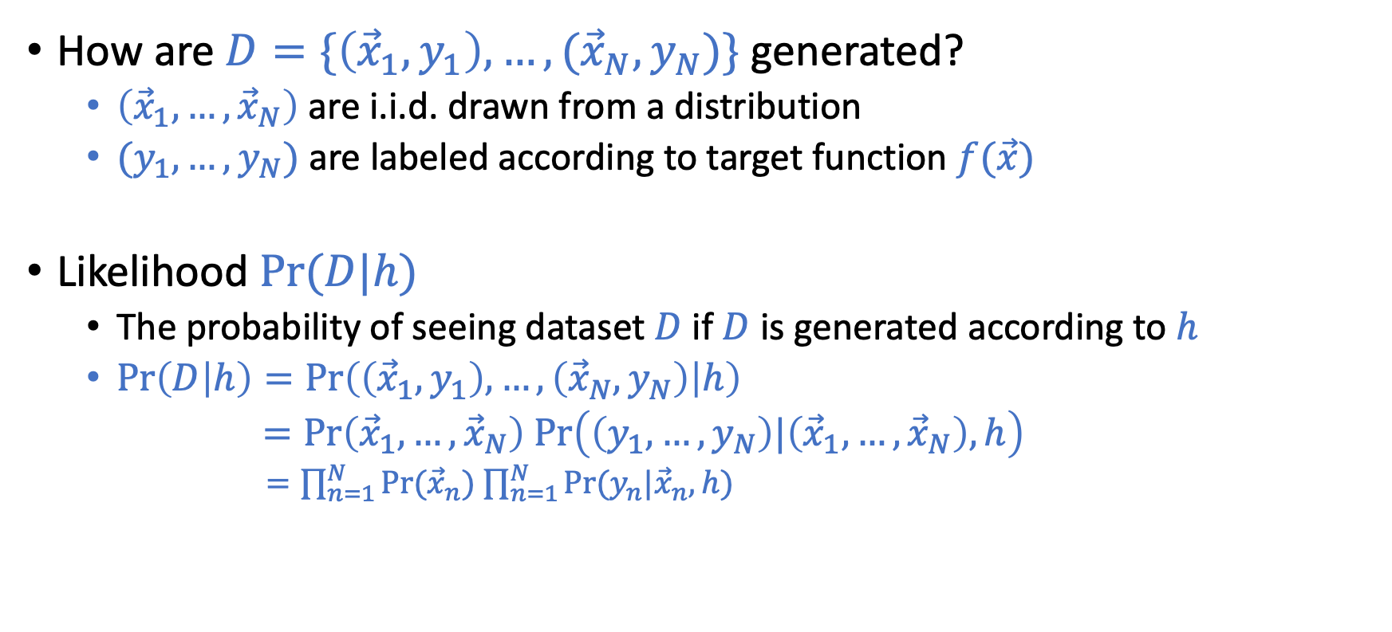
Write Down the Likelihood
How are $D=\{\left({\vec{x}}_{1},y_{1}\right),…,({\vec{x}}_{N},y_{N})\}$ generated?
$\left({\vec{x}}_{1},…,{\vec{x}}_{N}\right)$ are i.i.d. drawn from a distribution
$(y_{1},…,y_{N})$ are labeled according to target function $f(\vec{x})$
Likelihood $Pr⁡(D|h)$
The probability of seeing dataset $D$ if $D$is generated according to $h$
$\operatorname{Pr}\left(D | h\right)=\operatorname{Pr}\left(\left({\vec{x}}_{1},y_{1}\right),…,\left({\vec{x}}_{N},y_{N}\right) | h\right)$
$=Pr\left({\vec{x}}_{1},…,{\vec{x}}_{N}\right) Pr\left(\left(y_{1},…,y_{N}\right)|\left({\vec{x}}_{1},…,{\vec{x}}_{N}\right), h\right)$
$=\prod_{n=1}^{N}{Pr⁡({\vec{x}}_{n})}$ $\prod_{n=1}^{N}{Pr⁡(y_{n}|{\vec{x}}_{n}, h)}$
(Assumption of independent data)

Slide 18
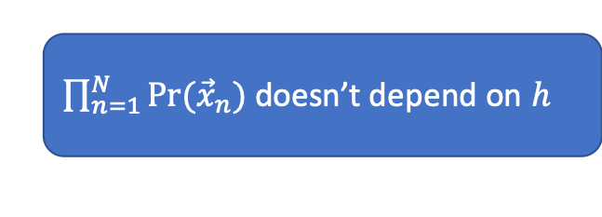
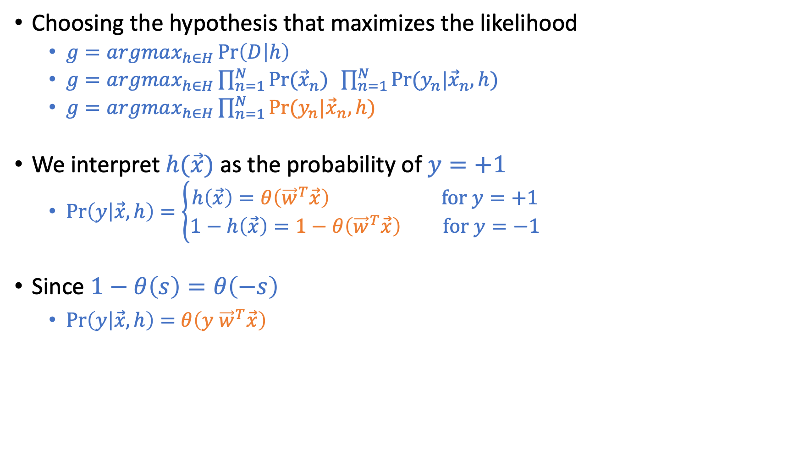
Maximum Likelihood
Choosing the hypothesis that maximizes the likelihood
$g=argmax_{h∈H}\operatorname{Pr}\left(D | h\right)$
$g=argmax_{h∈H}\prod_{n=1}^{N}{Pr⁡({\vec{x}}_{n})} \prod_{n=1}^{N}{Pr⁡(y_{n}|{\vec{x}}_{n}, h)}$
$g=argmax_{h∈H}\prod_{n=1}^{N}{Pr⁡(y_{n}|{\vec{x}}_{n}, h)}$
We interpret $h(\vec{x})$ as the probability of $y=+1$
$\operatorname{Pr}\left(y | \vec{x},h\right)=\left\{\begin{aligned}h\left(\vec{x}\right)=θ\left({\vec{w}}^{T}\vec{x}\right) \text{for} y=+1 \\ 1−h\left(\vec{x}\right)=1−θ\left({\vec{w}}^{T}\vec{x}\right) \text{for} y=−1\end{aligned}\right.$
Since $1−θ\left(s\right)=θ\left(−s\right)$
$\operatorname{Pr}\left(y | \vec{x},h\right)=$ $θ\left(y {\vec{w}}^{T}\vec{x}\right)$
$\prod_{n=1}^{N}{Pr⁡({\vec{x}}_{n})}$ doesn’t depend on $h$

Slide 19
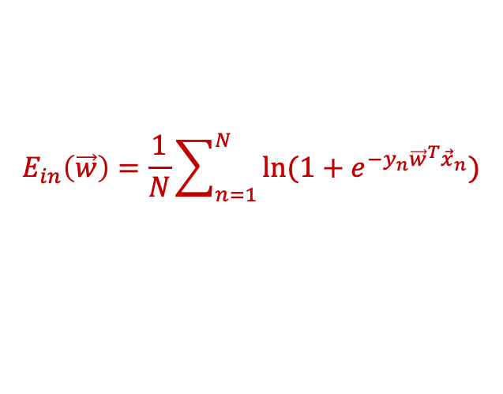
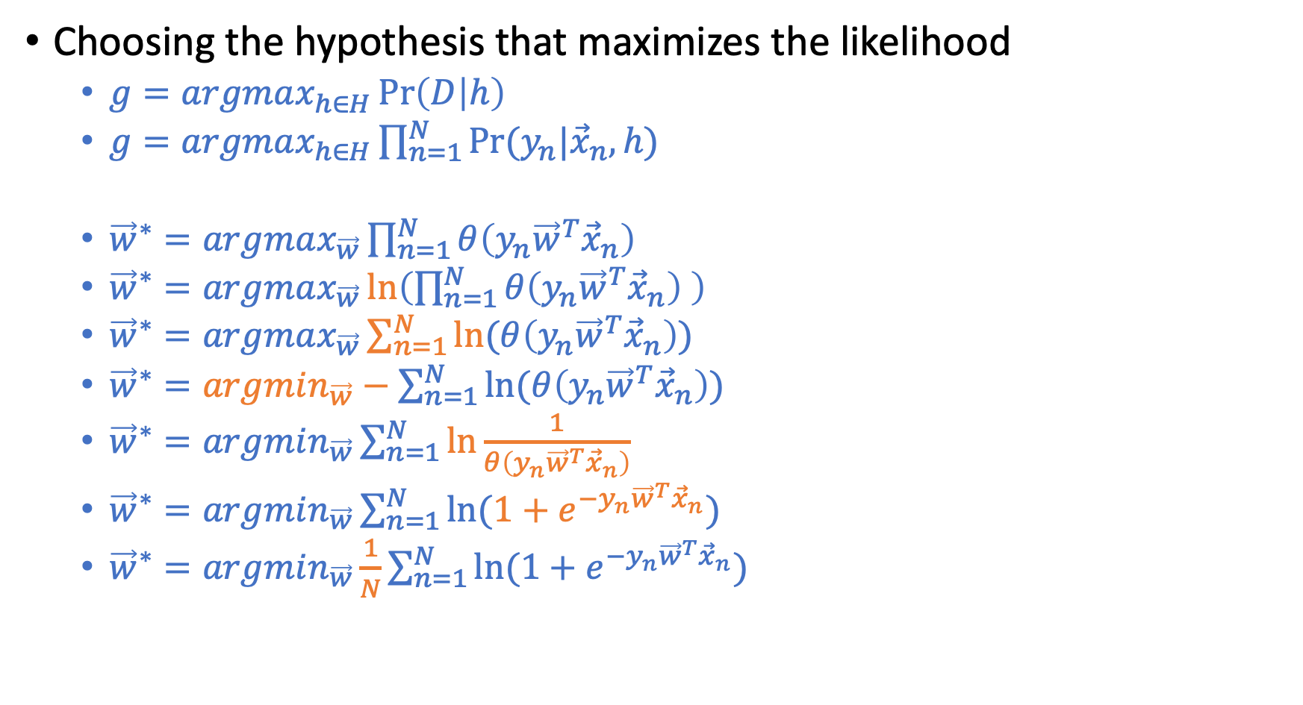
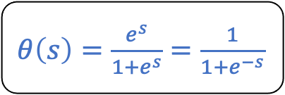
Maximum Likelihood
Choosing the hypothesis that maximizes the likelihood
$g=argmax_{h∈H}\operatorname{Pr}\left(D | h\right)$
$g=argmax_{h∈H}\prod_{n=1}^{N}{Pr⁡(y_{n}|{\vec{x}}_{n}, h)}$
${\vec{w}}^{∗}=argmax_{\vec{w}}\prod_{n=1}^{N}{θ\left(y_{n}{\vec{w}}^{T}{\vec{x}}_{n}\right) }$
${\vec{w}}^{∗}=argmax_{\vec{w}}\ln\left(\prod_{n=1}^{N}{θ\left(y_{n}{\vec{w}}^{T}{\vec{x}}_{n}\right) }\right)$
${\vec{w}}^{∗}=argmax_{\vec{w}}\sum_{n=1}^{N}{ln⁡(θ\left(y_{n}{\vec{w}}^{T}{\vec{x}}_{n}\right))}{}$
${\vec{w}}^{∗}=argmin_{\vec{w}}−\sum_{n=1}^{N}{ln⁡(θ\left(y_{n}{\vec{w}}^{T}{\vec{x}}_{n}\right))}$
${\vec{w}}^{∗}=argmin_{\vec{w}}\sum_{n=1}^{N}{ln\frac{1}{θ\left(y_{n}{\vec{w}}^{T}{\vec{x}}_{n}\right)}}$
${\vec{w}}^{∗}=argmin_{\vec{w}}\sum_{n=1}^{N}{ln(1+e^{−y_{n}{\vec{w}}^{T}{\vec{x}}_{n}})}$
${\vec{w}}^{∗}=argmin_{\vec{w}}\frac{1}{N}\sum_{n=1}^{N}{ln(1+e^{−y_{n}{\vec{w}}^{T}{\vec{x}}_{n}})}$
$θ\left(s\right)=\frac{e^{s}}{1+e^{s}}=\frac{1}{1+e^{−s}}$
$$E_{in}\left(\vec{w}\right)=\frac{1}{N}\sum_{n=1}^{N}{\ln{(1+e^{−y_{n}{\vec{w}}^{T}{\vec{x}}_{n}})}}$$

Slide 20
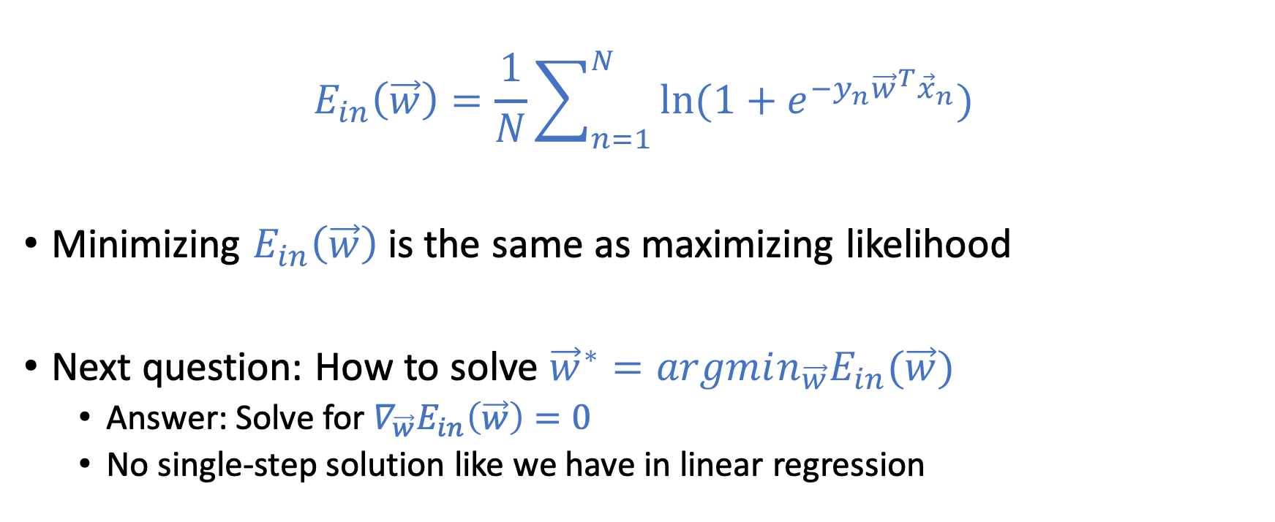
Cross Entropy Error
$$E_{in}\left(\vec{w}\right)=\frac{1}{N}\sum_{n=1}^{N}{\ln{(1+e^{−y_{n}{\vec{w}}^{T}{\vec{x}}_{n}})}}$$
Minimizing $E_{in}\left(\vec{w}\right)$ is the same as maximizing likelihood
Next question: How to solve ${\vec{w}}^{∗}=argmin_{\vec{w}}E_{in}(\vec{w})$
Answer: Solve for $∇_{\vec{w}}E_{in}\left(\vec{w}\right)=0$
No single-step solution like we have in linear regression

Slide 21
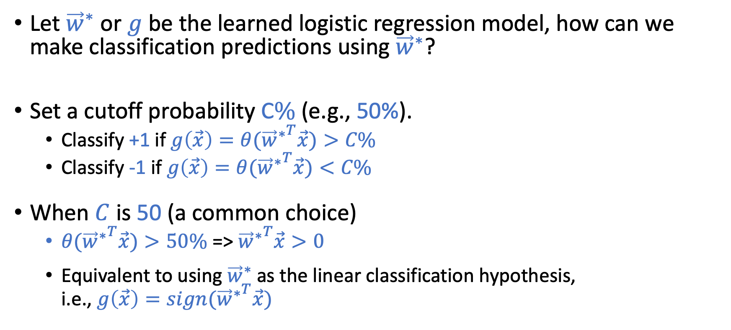
Using Logistic Regression for Classification
Let ${\vec{w}}^{∗}$ or $g$ be the learned logistic regression model, how can we make classification predictions using ${\vec{w}}^{∗}$?
Set a cutoff probability C$\%$ (e.g., 50%).
Classify +1 if $g\left(\vec{x}\right)=θ({{\vec{w}}^{∗}}^{T}\vec{x})>C\%$
Classify -1 if $g\left(\vec{x}\right)=θ({{\vec{w}}^{∗}}^{T}\vec{x})<C\%$
When $C$ is 50 (a common choice)
$θ({{\vec{w}}^{∗}}^{T}\vec{x})>50\%$ => ${{\vec{w}}^{∗}}^{T}\vec{x}>0$
Equivalent to using ${\vec{w}}^{∗}$ as the linear classification hypothesis, i.e., $g\left(\vec{x}\right)=sign({{\vec{w}}^{∗}}^{T}\vec{x})$

Slide 22
Gradient Descent
A general optimization technique

Slide 23
Gradient Descent
A technique for optimizing functions that gradients exist everywhere.
An iterative method that converges to local optimum.
Converge to global optimum if the function is convex (since there is only one local optimum).

Slide 24
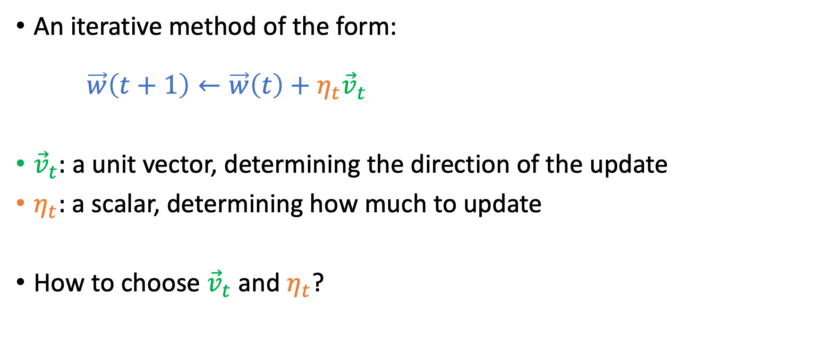

Gradient Descent: Minimizing $E_{in}(\vec{w})$
An iterative method of the form: $\vec{w}\left(t+1\right)←\vec{w}\left(t\right)+η_{t}{\vec{v}}_{t}$
${\vec{v}}_{t}:$ a unit vector, determining the direction of the update
$η_{t}:$ a scalar, determining how much to update
How to choose ${\vec{v}}_{t}$ and $η_{t}$?

Slide 25
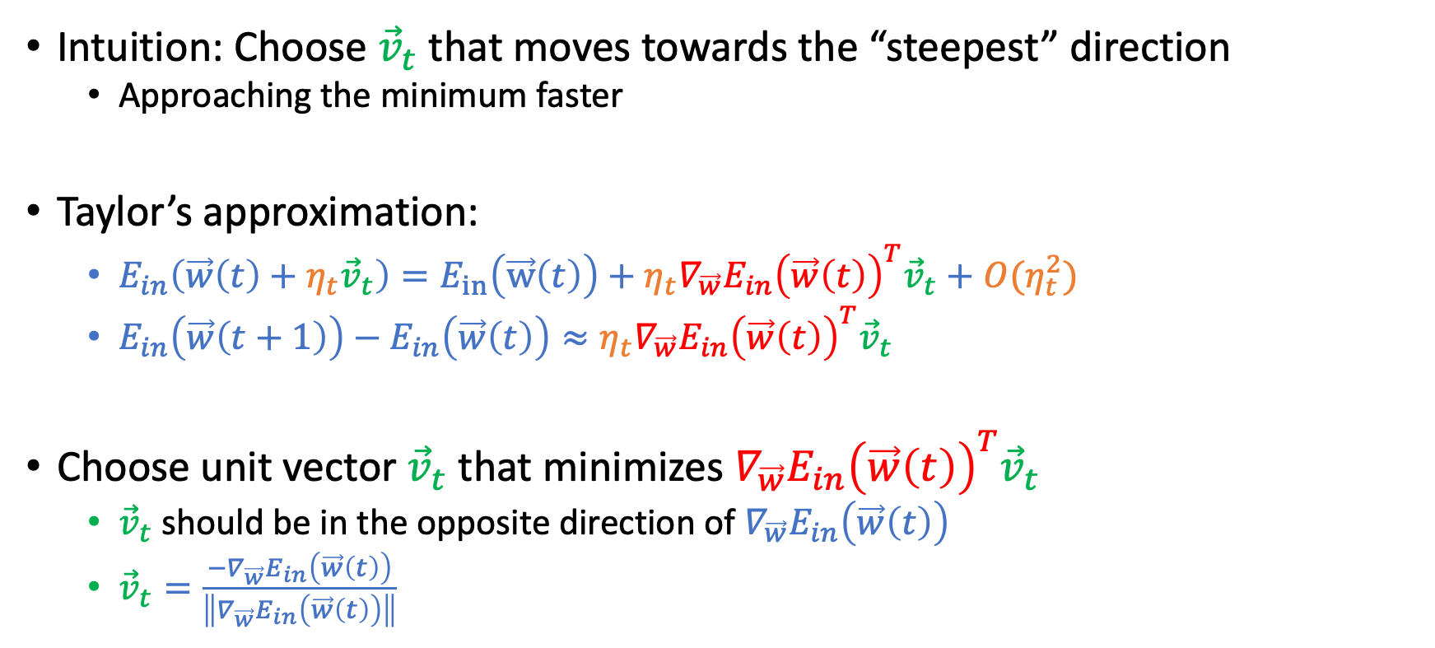


Choosing ${\vec{v}}_{t}$ in $\vec{w}\left(t+1\right)←\vec{w}\left(t\right)+η_{t}{\vec{v}}_{t}$
Intuition: Choose ${\vec{v}}_{t}$ that moves towards the “steepest” direction
Approaching the minimum faster
Taylor’s approximation:
$E_{in}\left(\vec{w}\left(t\right)+η_{t}{\vec{v}}_{t}\right)=E_{in}\left(\vec{w}\left(t\right)\right)+η_{t}∇_{\vec{w}}E_{in}{\left(\vec{w}\left(t\right)\right)}^{T}{\vec{v}}_{t}+O(η_{t}^{2})$
$E_{in}\left(\vec{w}\left(t+1\right)\right)−E_{in}\left(\vec{w}\left(t\right)\right)≈η_{t}∇_{\vec{w}}E_{in}{\left(\vec{w}\left(t\right)\right)}^{T}{\vec{v}}_{t}$
Choose unit vector ${\vec{v}}_{t}$ that minimizes $∇_{\vec{w}}E_{in}{\left(\vec{w}\left(t\right)\right)}^{T}{\vec{v}}_{t}$
${\vec{v}}_{t}$ should be in the opposite direction of $∇_{\vec{w}}E_{in}\left(\vec{w}\left(t\right)\right)$
${\vec{v}}_{t}=\frac{{−∇}_{\vec{w}}E_{in}\left(\vec{w}\left(t\right)\right)}{\left\|∇_{\vec{w}}E_{in}\left(\vec{w}\left(t\right)\right)\right\|}$
$η_{t}$ is usually small, so ignore this term

Slide 26

Choosing $η_{t}$ in $\vec{w}\left(t+1\right)←\vec{w}\left(t\right)+η_{t}{\vec{v}}_{t}$

Slide 27
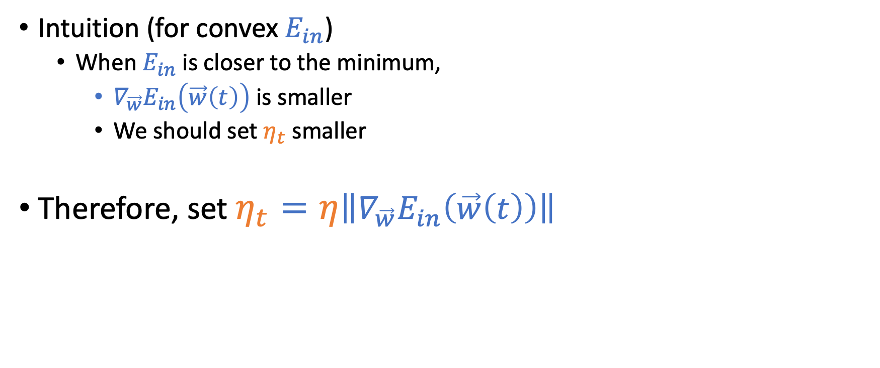
Choosing $η_{t}$ in $\vec{w}\left(t+1\right)←\vec{w}\left(t\right)+η_{t}{\vec{v}}_{t}$
Intuition (for convex $E_{in}$)
When $E_{in}$ is closer to the minimum,
$∇_{\vec{w}}E_{in}\left(\vec{w}\left(t\right)\right)$ is smaller
We should set $η_{t}$ smaller
Therefore, set $η_{t}=η\left\|∇_{\vec{w}}E_{in}\left(\vec{w}\left(t\right)\right)\right\|$

Slide 28
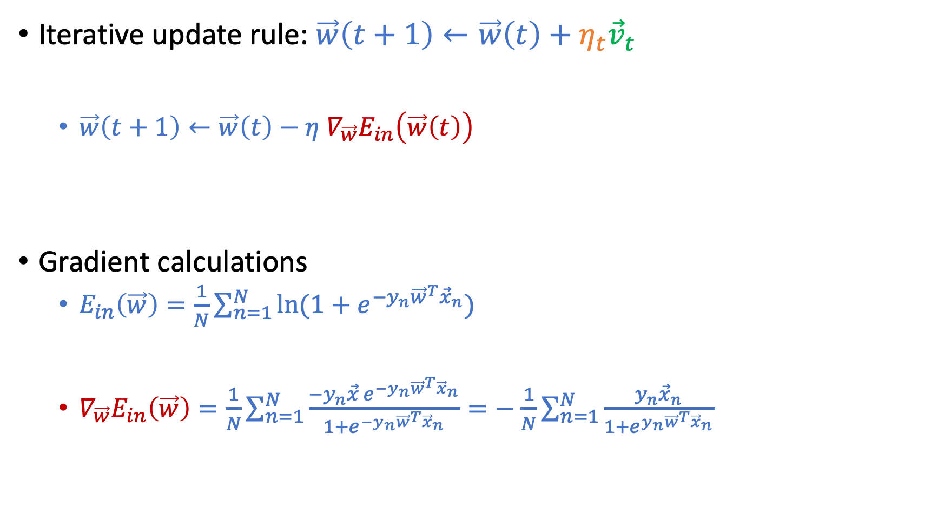
Putting Them Together
Iterative update rule: $\vec{w}\left(t+1\right)←\vec{w}\left(t\right)+η_{t}{\vec{v}}_{t}$
$\vec{w}\left(t+1\right)←\vec{w}\left(t\right)−η$ $∇_{\vec{w}}E_{in}\left(\vec{w}\left(t\right)\right)$
Gradient calculations
$E_{in}\left(\vec{w}\right)=\frac{1}{N}\sum_{n=1}^{N}{\ln{(1+e^{−y_{n}{\vec{w}}^{T}{\vec{x}}_{n}})}}$
$∇_{\vec{w}}E_{in}\left(\vec{w}\right)=\frac{1}{N}\sum_{n=1}^{N}{\frac{−y_{n}\vec{x} e^{−y_{n}{\vec{w}}^{T}{\vec{x}}_{n}}}{1+e^{−y_{n}{\vec{w}}^{T}{\vec{x}}_{n}}}}=−$ $\frac{1}{N}\sum_{n=1}^{N}{\frac{y_{n}{\vec{x}}_{n}}{1+e^{y_{n}{\vec{w}}^{T}{\vec{x}}_{n}}}}$

Slide 29
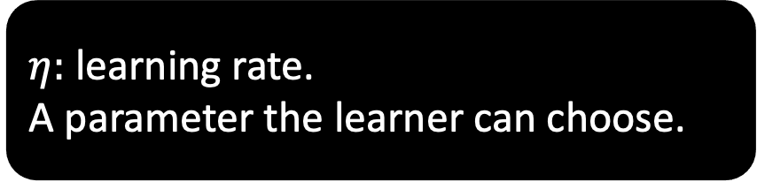
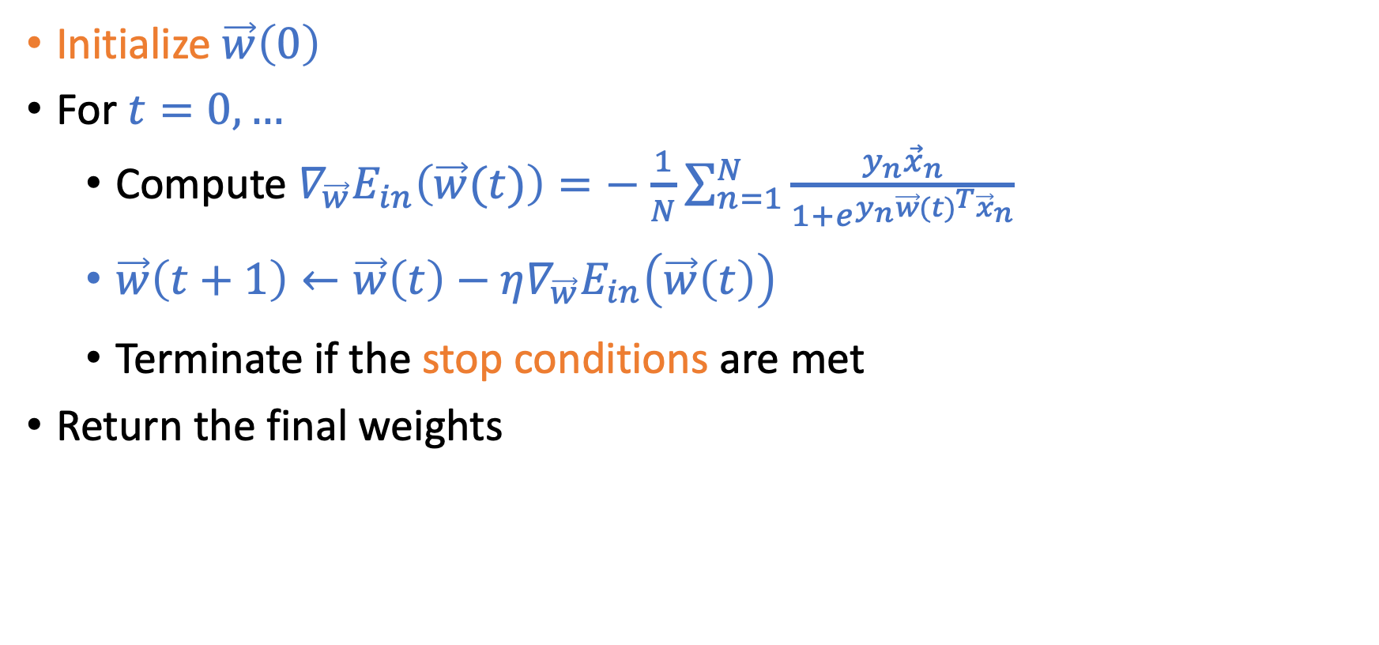
Gradient Descent for Logistic Regression
Initialize $\vec{w}\left(0\right)$
For $t=0,…$
Compute $∇_{\vec{w}}E_{in}\left(\vec{w}(t)\right)=−$ $\frac{1}{N}\sum_{n=1}^{N}{\frac{y_{n}{\vec{x}}_{n}}{1+e^{y_{n}{\vec{w}(t)}^{T}{\vec{x}}_{n}}}}$
$\vec{w}\left(t+1\right)←\vec{w}\left(t\right)−η∇_{\vec{w}}E_{in}\left(\vec{w}\left(t\right)\right)$
Terminate if the stop conditions are met
Return the final weights
$η:$ learning rate. A parameter the learner can choose.

Slide 30
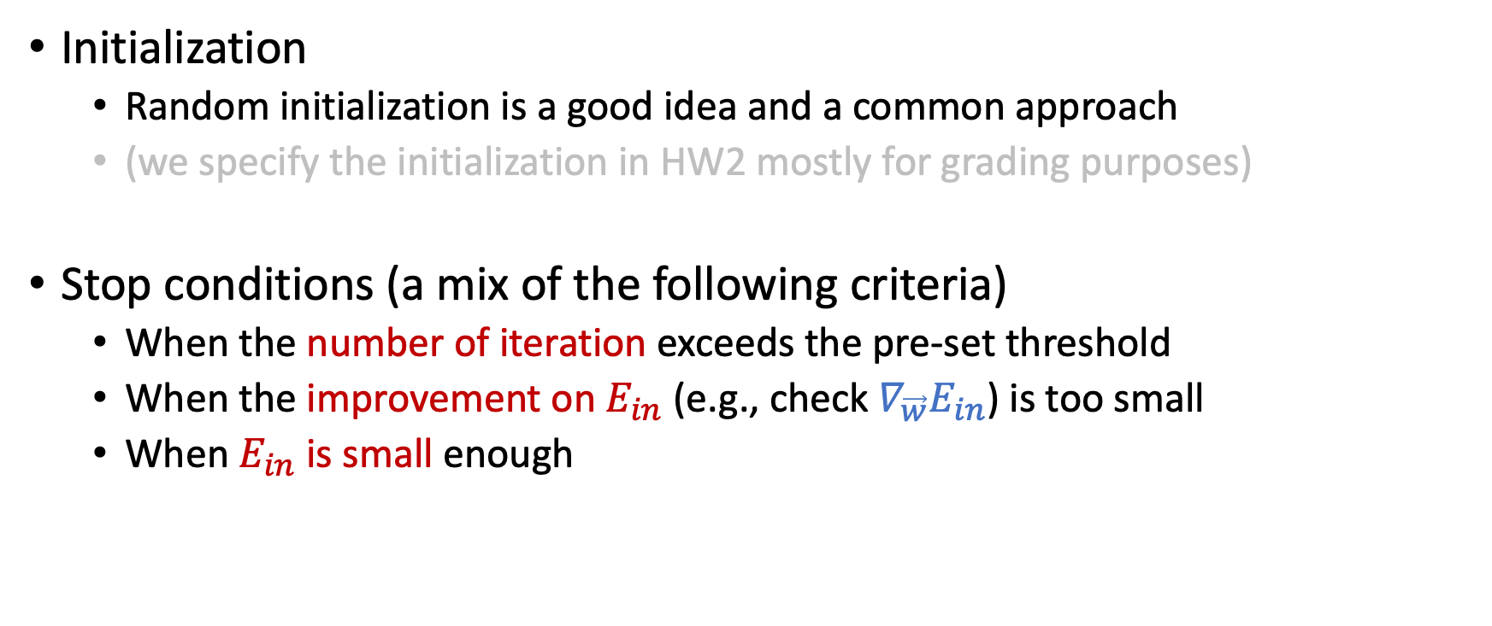
Gradient Descent for Logistic Regression
Initialization
Random initialization is a good idea and a common approach
(we specify the initialization in HW2 mostly for grading purposes)
Stop conditions (a mix of the following criteria)
When the number of iteration exceeds the pre-set threshold
When the improvement on $E_{in}$ (e.g., check $∇_{\vec{w}}E_{in}$) is too small
When $E_{in}$ is small enough

Slide 31
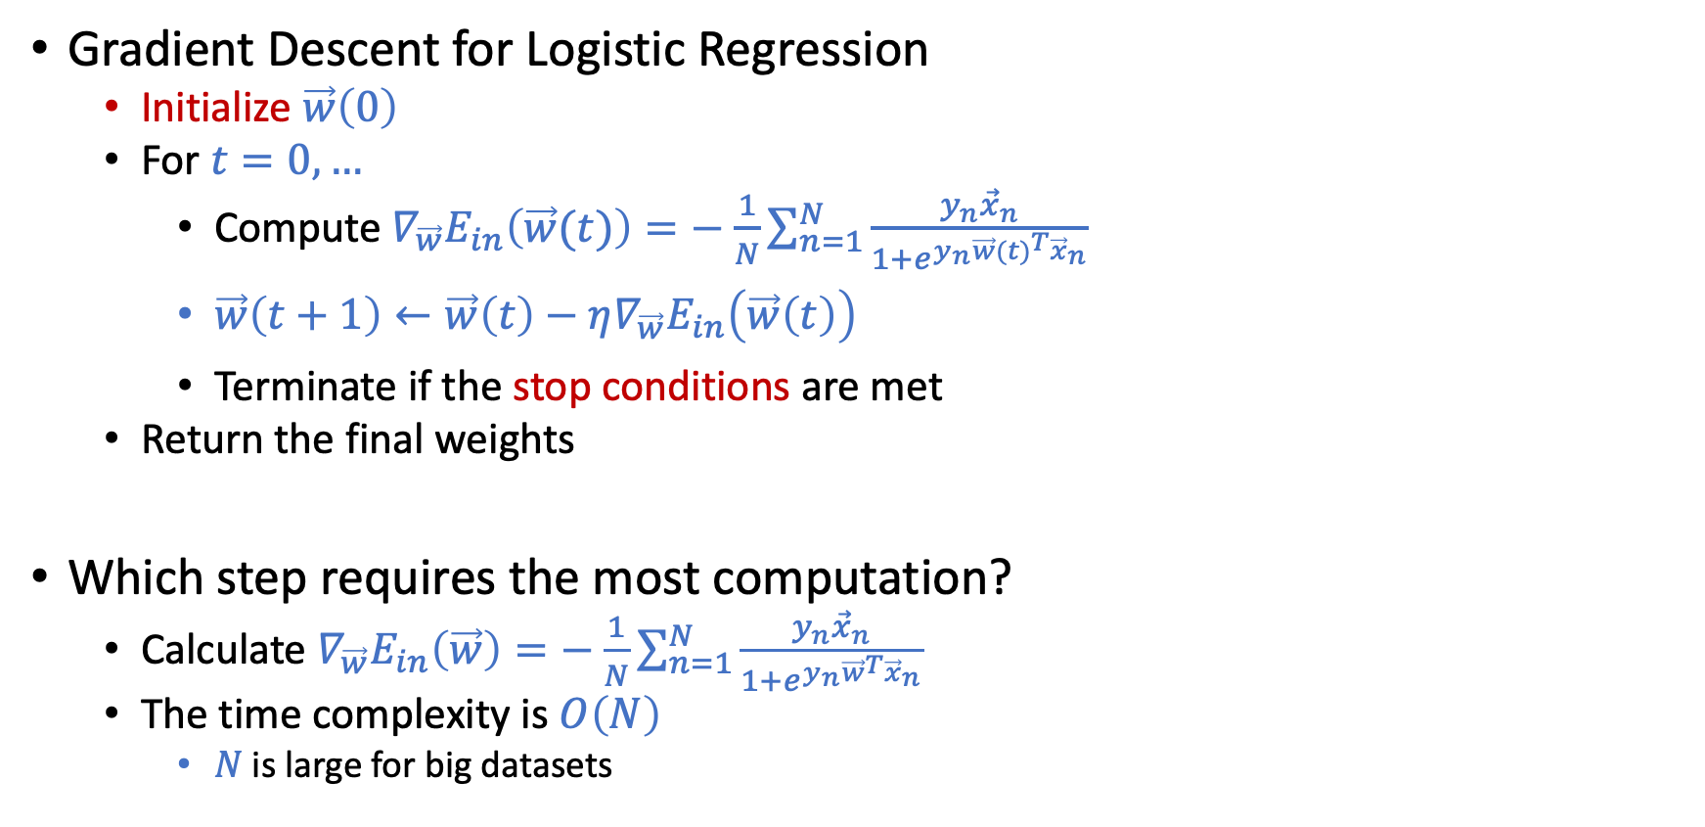
Computation of Gradient Descent
Gradient Descent for Logistic Regression
Initialize $\vec{w}\left(0\right)$
For $t=0,…$
Compute $∇_{\vec{w}}E_{in}\left(\vec{w}(t)\right)=−$ $\frac{1}{N}\sum_{n=1}^{N}{\frac{y_{n}{\vec{x}}_{n}}{1+e^{y_{n}{\vec{w}(t)}^{T}{\vec{x}}_{n}}}}$
$\vec{w}\left(t+1\right)←\vec{w}\left(t\right)−η∇_{\vec{w}}E_{in}\left(\vec{w}\left(t\right)\right)$
Terminate if the stop conditions are met
Return the final weights
Which step requires the most computation?
Calculate $∇_{\vec{w}}E_{in}\left(\vec{w}\right)=−$ $\frac{1}{N}\sum_{n=1}^{N}{\frac{y_{n}{\vec{x}}_{n}}{1+e^{y_{n}{\vec{w}}^{T}{\vec{x}}_{n}}}}$
The time complexity is $O\left(N\right)$
$N$ is large for big datasets

Slide 32
Stochastic Gradient Descent

Slide 33
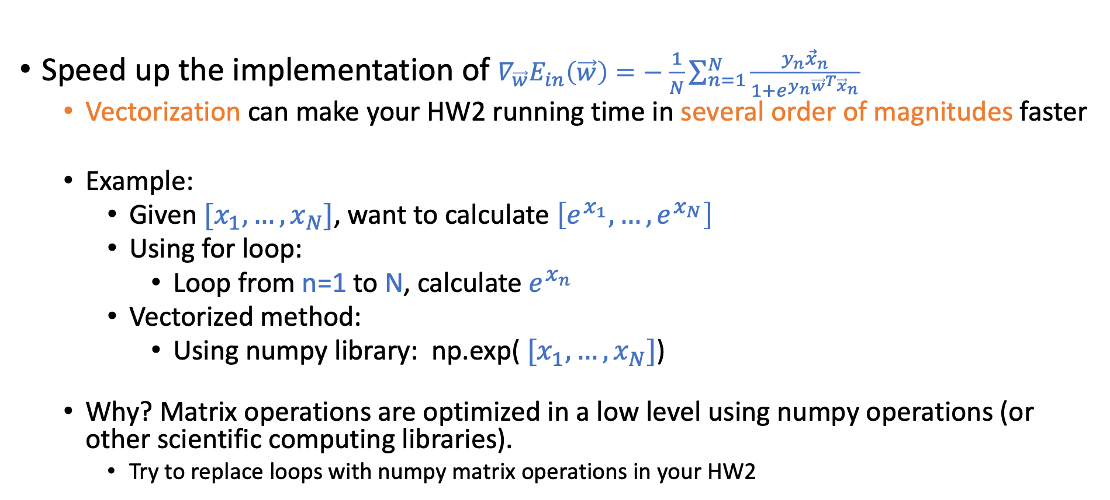

Deal with Heavy Computation of $∇_{\vec{w}}E_{in}\left(\vec{w}\right)$
Speed up the implementation of $∇_{\vec{w}}E_{in}\left(\vec{w}\right)=−$ $\frac{1}{N}\sum_{n=1}^{N}{\frac{y_{n}{\vec{x}}_{n}}{1+e^{y_{n}{\vec{w}}^{T}{\vec{x}}_{n}}}}$
Vectorization can make your HW2 running time in several order of magnitudes faster
Example:
Given${ [x}_{1},…,x_{N}]$, want to calculate $\left[e^{x_{1}},…,e^{x_{N}}\right]$
Using for loop:
Loop from n=1 to N, calculate $e^{x_{n}}$
Vectorized method:
Using numpy library: np.exp(${ [x}_{1},…,x_{N}]$)
Why? Matrix operations are optimized in a low level using numpy operations (or other scientific computing libraries).
Try to replace loops with numpy matrix operations in your HW2

Slide 34
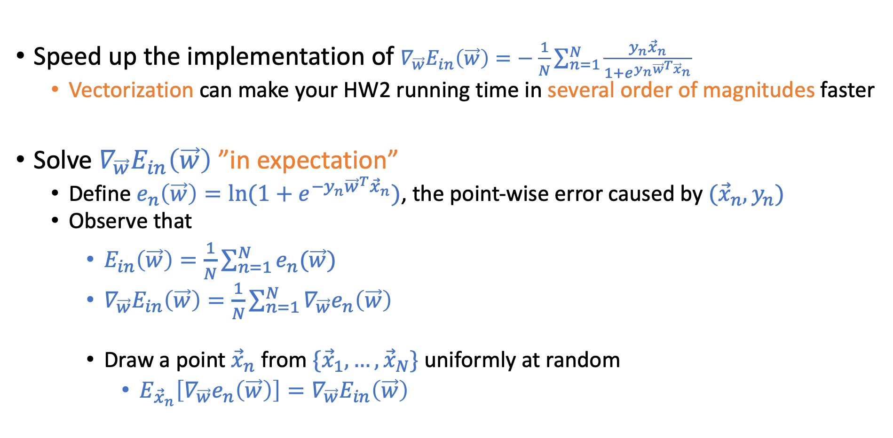
Deal with Heavy Computation of $∇_{\vec{w}}E_{in}\left(\vec{w}\right)$
Speed up the implementation of $∇_{\vec{w}}E_{in}\left(\vec{w}\right)=−$ $\frac{1}{N}\sum_{n=1}^{N}{\frac{y_{n}{\vec{x}}_{n}}{1+e^{y_{n}{\vec{w}}^{T}{\vec{x}}_{n}}}}$
Vectorization can make your HW2 running time in several order of magnitudes faster
Solve $∇_{\vec{w}}E_{in}\left(\vec{w}\right)$ ”in expectation”
Define $e_{n}\left(\vec{w}\right)=\ln{(1+e^{−y_{n}{\vec{w}}^{T}{\vec{x}}_{n}})}$, the point-wise error caused by $({\vec{x}}_{n},y_{n})$
Observe that
$E_{in}\left(\vec{w}\right)=\frac{1}{N}\sum_{n=1}^{N}{e_{n}(\vec{w})}$
$∇_{\vec{w}}E_{in}\left(\vec{w}\right)=\frac{1}{N}\sum_{n=1}^{N}{∇_{\vec{w}}e_{n}\left(\vec{w}\right)}$
Draw a point ${\vec{x}}_{n}$ from $\{{\vec{x}}_{1},…,{\vec{x}}_{N}\}$ uniformly at random
$E_{{\vec{x}}_{n}}\left[∇_{\vec{w}}e_{n}\left(\vec{w}\right)\right]=∇_{\vec{w}}E_{in}\left(\vec{w}\right)$

Slide 35
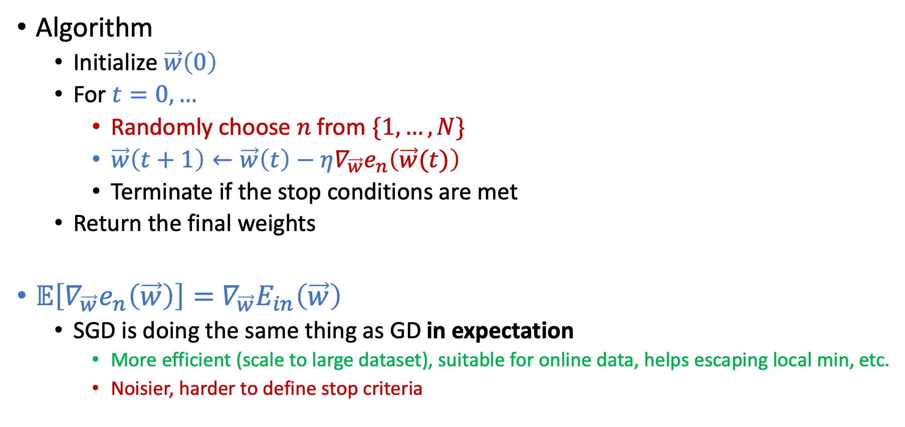
Stochastic Gradient Descent (SGD)
Algorithm
Initialize $\vec{w}\left(0\right)$
For $t=0,…$
Randomly choose $n$ from $\{1,…,N\}$
$\vec{w}\left(t+1\right)←\vec{w}\left(t\right)−η∇_{\vec{w}}e_{n}\left(\vec{w}(t)\right)$
Terminate if the stop conditions are met
Return the final weights
$𝔼\left[∇_{\vec{w}}e_{n}\left(\vec{w}\right)\right]=$ $∇_{\vec{w}}E_{in}\left(\vec{w}\right)$
SGD is doing the same thing as GD in expectation
More efficient (scale to large dataset), suitable for online data, helps escaping local min, etc.
Noisier, harder to define stop criteria

Slide 36
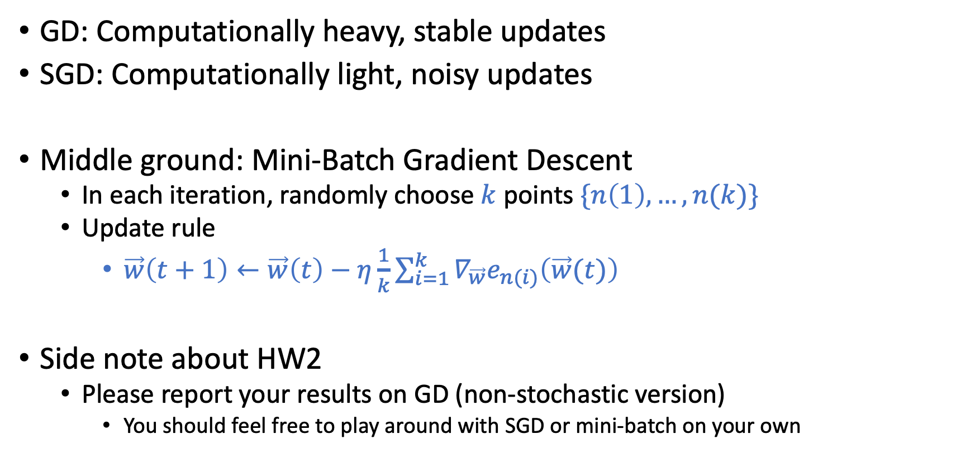
Mini-Batch Gradient Descent
GD: Computationally heavy, stable updates
SGD: Computationally light, noisy updates
Middle ground: Mini-Batch Gradient Descent
In each iteration, randomly choose $k$ points $\{n\left(1\right),…,n(k)\}$
Update rule
$\vec{w}\left(t+1\right)←\vec{w}\left(t\right)−η\frac{1}{k}\sum_{i=1}^{k}{∇_{\vec{w}}e_{n(i)}\left(\vec{w}(t)\right)}$
Side note about HW2
Please report your results on GD (non-stochastic version)
You should feel free to play around with SGD or mini-batch on your own

Slide 37
Non-Linear Transformation

Slide 38
Limitations of Linear Models

Slide 39
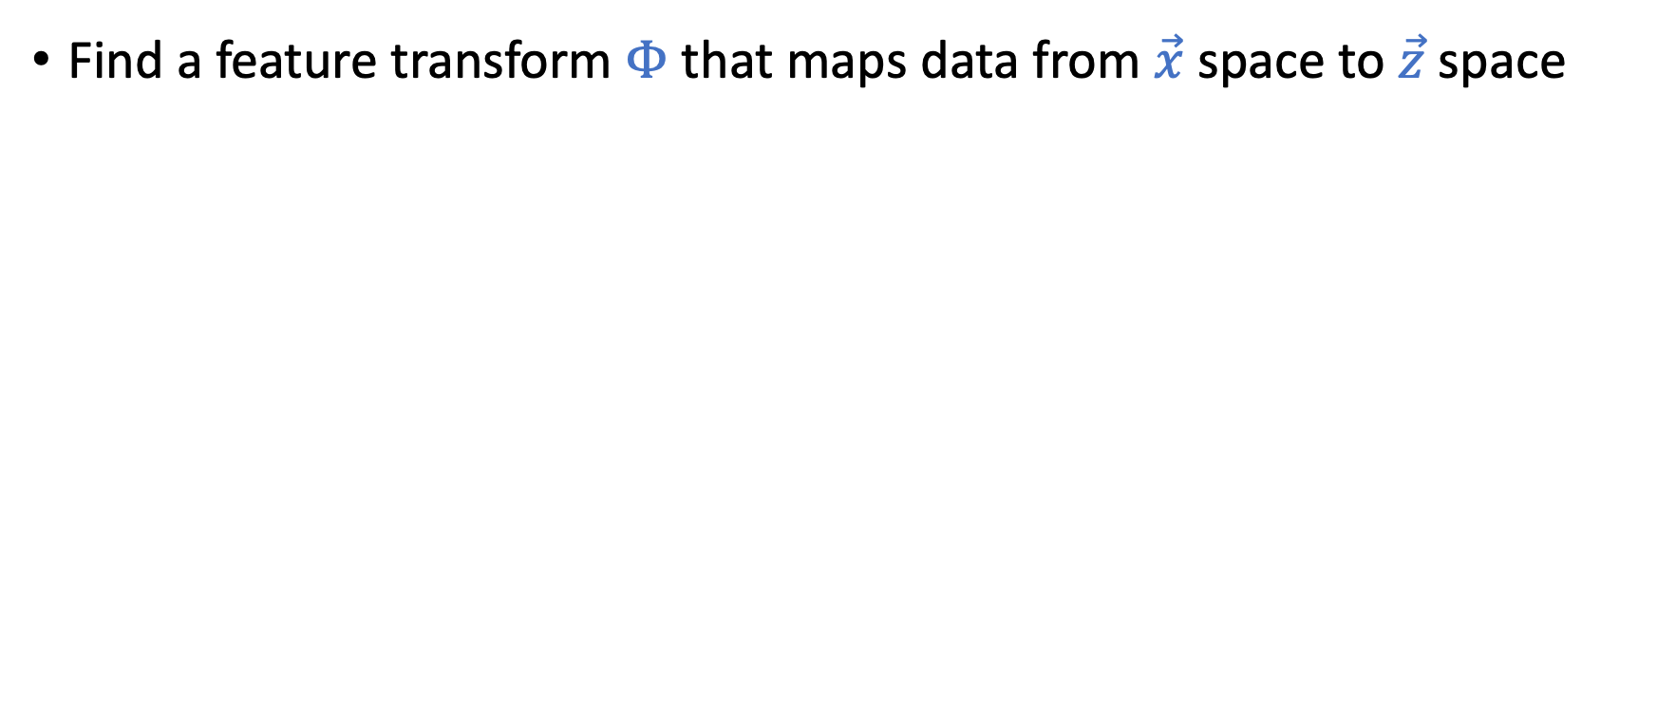
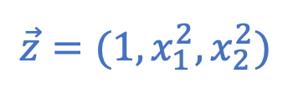
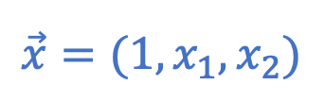
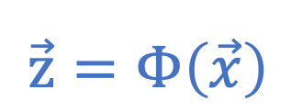
Using Non-Linear Transformations
Find a feature transform $Φ$ that maps data from $\vec{x}$ space to $\vec{z}$ space
$$\vec{z}=Φ\left(\vec{x}\right)$$
$$\vec{x}=(1,x_{1},x_{2})$$
$$\vec{z}=(1,x_{1}^{2},x_{2}^{2})$$

Slide 40
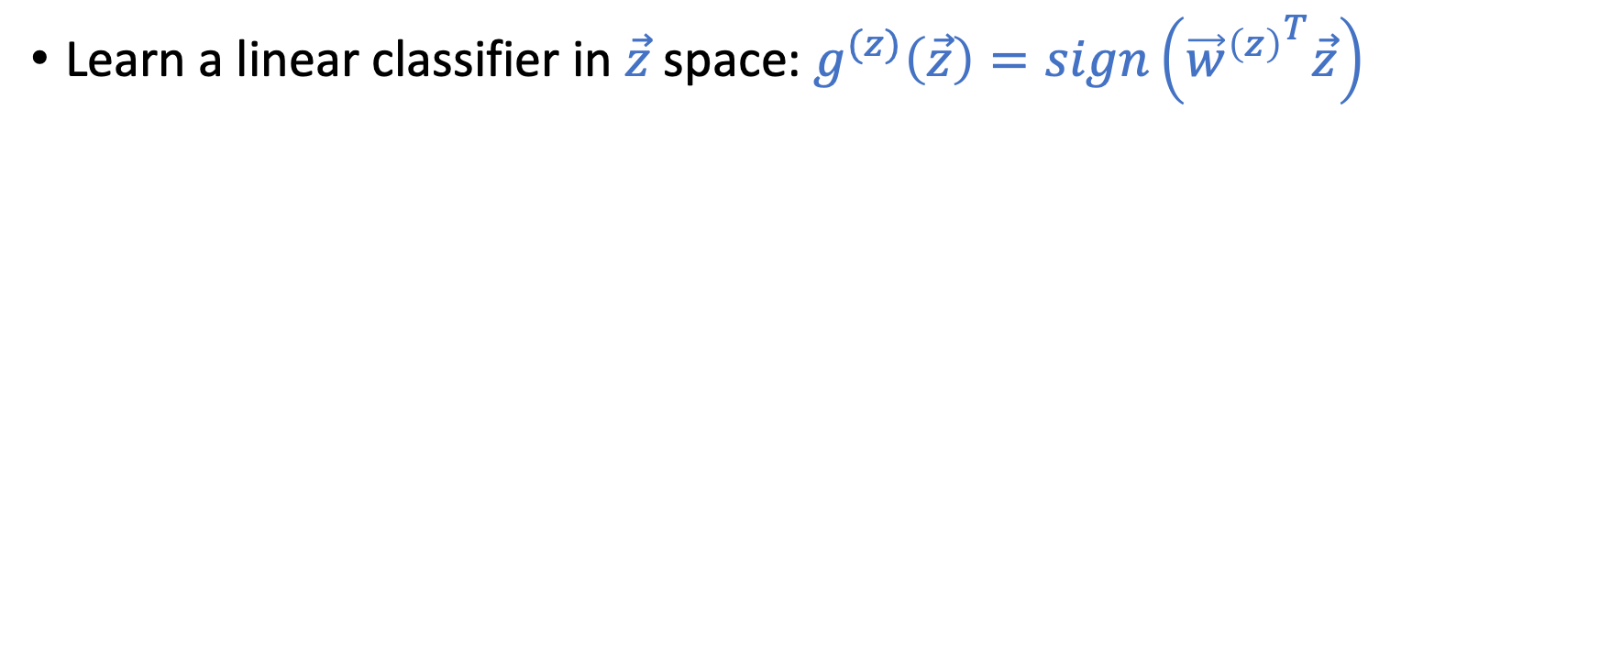
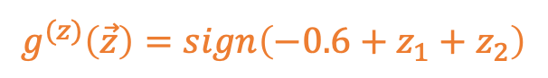
Using Non-Linear Transformations
Learn a linear classifier in $\vec{z}$ space: $g^{(z)}\left(\vec{z}\right)=sign\left({{\vec{w}}^{\left(z\right)}}^{T}\vec{z}\right)$
$$\vec{z}=Φ\left(\vec{x}\right)$$
$$\vec{x}=(1,x_{1},x_{2})$$
$$\vec{z}=(1,x_{1}^{2},x_{2}^{2})$$
$$g^{(z)}\left(\vec{z}\right)=sign\left(−0.6+z_{1}+z_{2}\right)$$

Slide 41
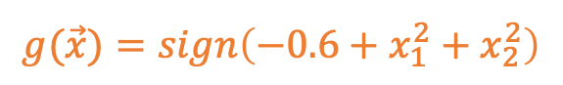
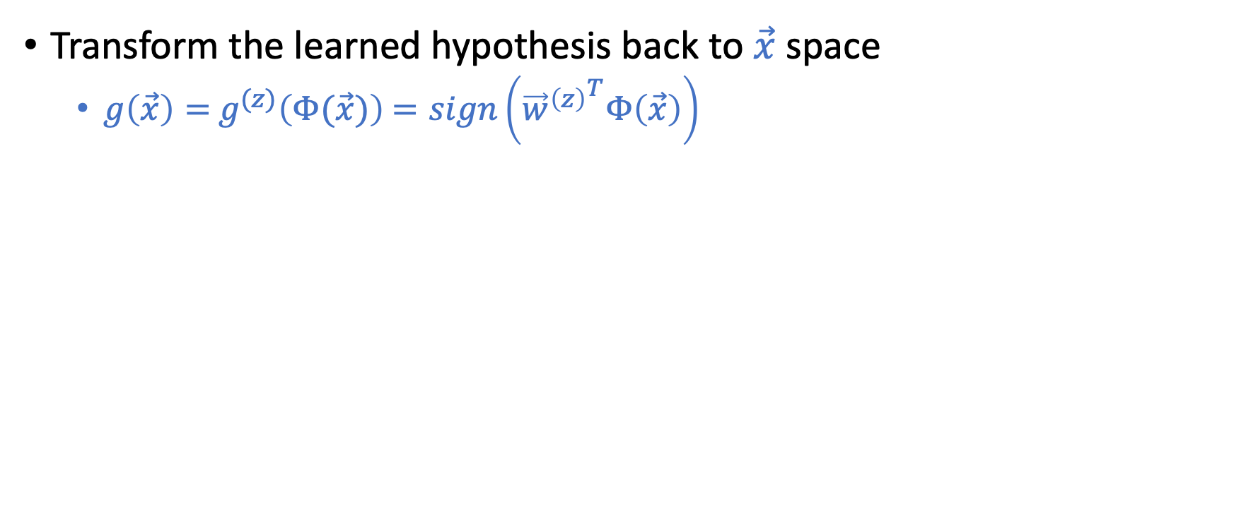
Using Non-Linear Transformations
Transform the learned hypothesis back to $\vec{x}$ space
$g\left(\vec{x}\right)=$ $g^{(z)}\left(Φ(\vec{x})\right)$ $=sign\left({{\vec{w}}^{\left(z\right)}}^{T}Φ\left(\vec{x}\right)\right)$
$$\vec{x}=(1,x_{1},x_{2})$$
$$\vec{z}=(1,x_{1}^{2},x_{2}^{2})$$
$$g(\vec{x})=sign\left(−0.6+x_{1}^{2}+x_{2}^{2}\right)$$
$$g^{(z)}\left(\vec{z}\right)=sign\left(−0.6+z_{1}+z_{2}\right)$$

Slide 42
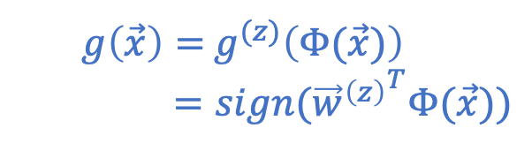
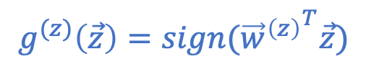
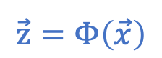
Nonlinear Transformation
$$\vec{z}=Φ\left(\vec{x}\right)$$
$$g^{(z)}\left(\vec{z}\right)=sign({{\vec{w}}^{\left(z\right)}}^{T}\vec{z})$$
$g\left(\vec{x}\right)=$ $g^{(z)}\left(Φ(\vec{x})\right)$
$=sign({{\vec{w}}^{\left(z\right)}}^{T}Φ(\vec{x}))$

Slide 43
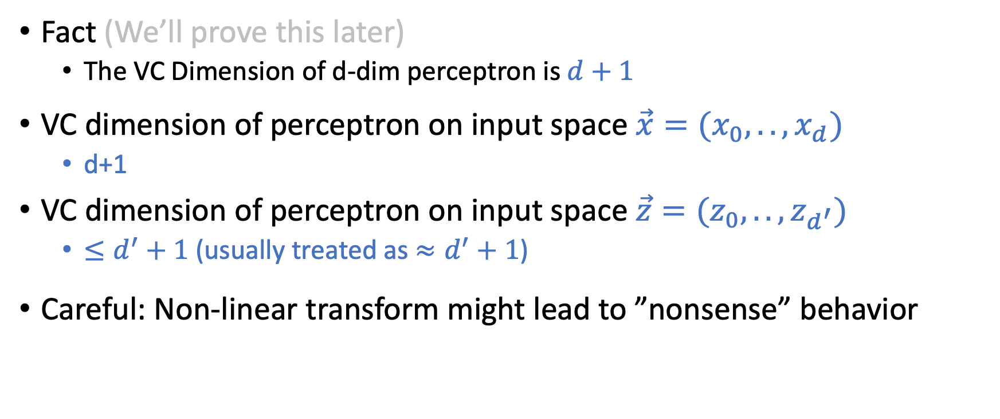
Generalization of Nonlinear Transformation
Fact (We’ll prove this later)
The VC Dimension of d-dim perceptron is $d+1$
VC dimension of perceptron on input space $\vec{x}=(x_{0},..,x_{d})$
d+1
VC dimension of perceptron on input space $\vec{z}=(z_{0},..,z_{d^{′}})$
$≤d^{′}+1$(usually treated as $≈d^{′}+1$)
Careful: Non-linear transform might lead to ”nonsense” behavior

Slide 44

How to Choose Feature Transform $Φ$

Slide 45
How to Choose Feature Transform $Φ$
Something Seems Wrong!

Slide 46
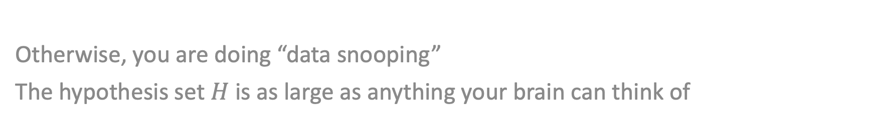

Must choose $Φ$ BEFORE looking at the data
Otherwise, you are doing “data snooping”
The hypothesis set $H$ is as large as anything your brain can think of

Slide 47
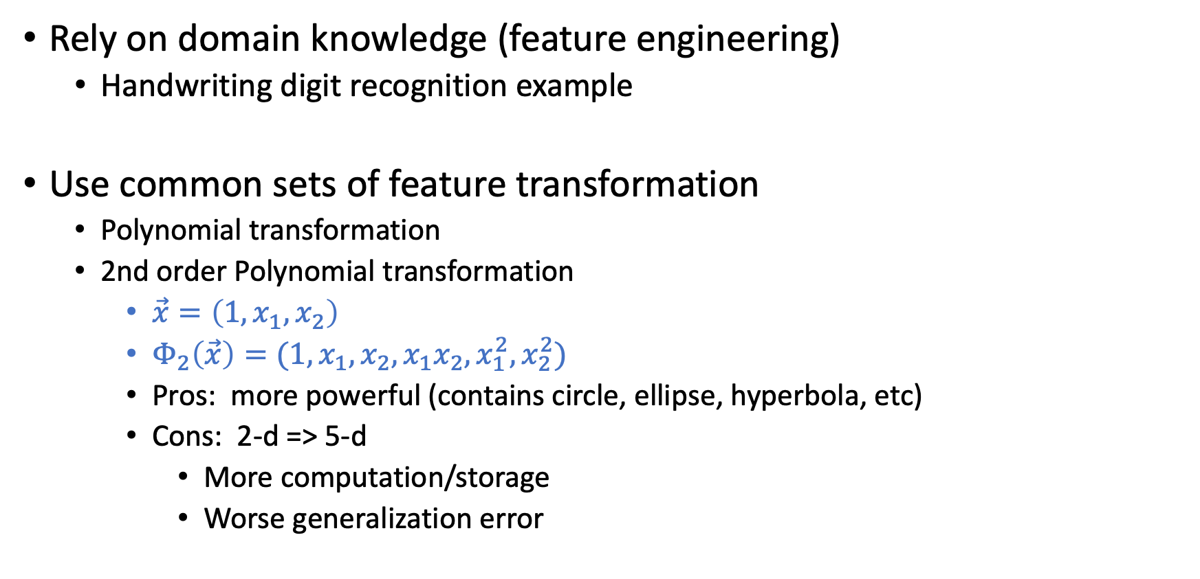

Choose $Φ$ Before Seeing Data
Rely on domain knowledge (feature engineering)
Handwriting digit recognition example
Use common sets of feature transformation
Polynomial transformation
2nd order Polynomial transformation
$\vec{x}=\left(1,x_{1},x_{2}\right)$
$Φ_{2}\left(\vec{x}\right)=(1,x_{1},x_{2},x_{1}x_{2},x_{1}^{2},x_{2}^{2})$
Pros: more powerful (contains circle, ellipse, hyperbola, etc)
Cons: 2-d => 5-d
More computation/storage
Worse generalization error
The VC dimension of d-dim perceptron is d+1

Slide 48
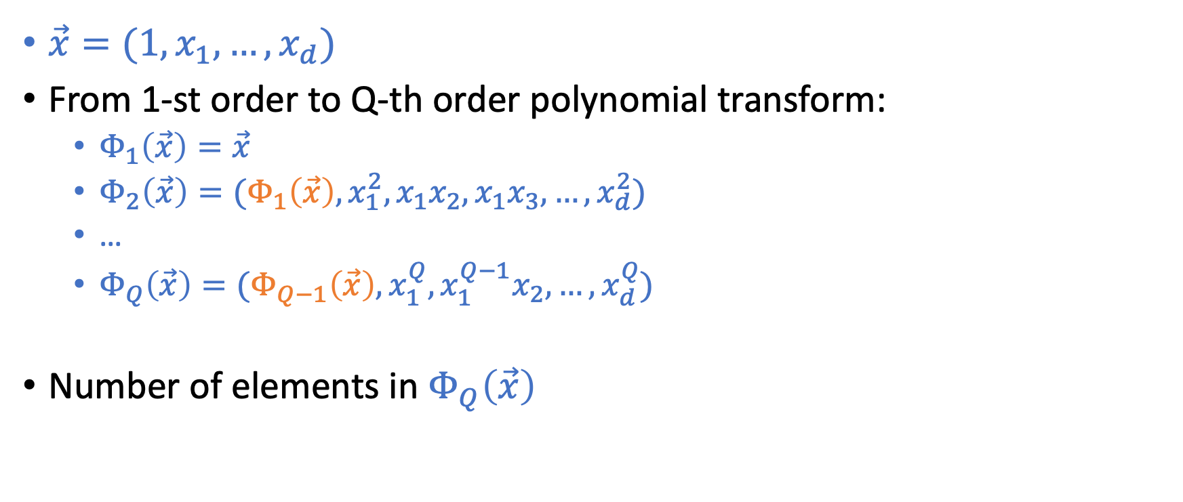
Q-th Order Polynomial Transform
$\vec{x}=(1,x_{1},…,x_{d})$
From 1-st order to Q-th order polynomial transform:
$Φ_{1}\left(\vec{x}\right)=\vec{x}$
$Φ_{2}\left(\vec{x}\right)=(Φ_{1}\left(\vec{x}\right),x_{1}^{2},x_{1}x_{2},x_{1}x_{3},…,x_{d}^{2})$
…
$Φ_{Q}\left(\vec{x}\right)=(Φ_{Q−1}\left(\vec{x}\right),x_{1}^{Q},x_{1}^{Q−1}x_{2},…,x_{d}^{Q})$
Number of elements in $Φ_{Q}\left(\vec{x}\right)$

Slide 49

Q-th Order Polynomial Transform
$\vec{x}=(1,x_{1},…,x_{d})$
From 1-st order to Q-th order polynomial transform:
$Φ_{1}\left(\vec{x}\right)=\vec{x}$
$Φ_{2}\left(\vec{x}\right)=(Φ_{1}\left(\vec{x}\right),x_{1}^{2},x_{1}x_{2},x_{1}x_{3},…,x_{d}^{2})$
…
$Φ_{Q}\left(\vec{x}\right)=(Φ_{Q−1}\left(\vec{x}\right),x_{1}^{Q},x_{1}^{Q−1}x_{2},…,x_{d}^{Q})$
Number of elements in $Φ_{Q}\left(\vec{x}\right)$
$\left(\begin{matrix}Q+d \\ Q\end{matrix}\right)$

Slide 50

Structural Hypothesis Sets
Let $H_{Q}$ be the linear model for the $Φ_{Q}(\vec{x})$ space
Let $g_{Q}=argmin_{h∈H_{Q}}E_{in}(h)$
$H_{0}⊂H_{1}⊂H_{2}…$
$d_{vc}\left(H_{0}\right)≤d_{vc}\left(H_{1}\right)≤d_{vc}\left(H_{2}\right)…$
$E_{in}\left(g_{0}\right)≥E_{in}\left(g_{1}\right)≥E_{in}\left(g_{2}\right)…$

Slide 51

Structural Hypothesis Sets
Let $H_{Q}$ be the linear model for the $Φ_{Q}(\vec{x})$ space
Let $g_{Q}=argmin_{h∈H_{Q}}E_{in}(h)$
$H_{0}⊂H_{1}⊂H_{2}…$
$d_{vc}\left(H_{0}\right)≤d_{vc}\left(H_{1}\right)≤d_{vc}\left(H_{2}\right)…$
$E_{in}\left(g_{0}\right)≥E_{in}\left(g_{1}\right)≥E_{in}\left(g_{2}\right)…$

